Slide 1
Treatment Services Bidder’s Conference
July __ 2021
10:00 am

Slide 2
Welcome
Introductions
What is U.S. Probation/
U.S. Pretrial Services
Treatment Services we are soliciting for

Slide 3
Solicitation
Fiscal year 2021
-October 1, 2021 to September 30, 2022
Possibility of extending for two additional years
-October 1, 2022 to September 30, 2023
-October 1, 2023 to September 30, 2024

Slide 4
How it works
Determine technical acceptability
-Is the program located in the catchment area?
-Is the program able to provide all services listed on the RFP? (can use subcontractors)
-Does the program have staff that meet the minimum qualifications?
-Is the proposal “complete?”

Slide 5
How it works, cont’d
Lowest bidder
On-site evaluation
Determine “responsibility”

Slide 6
Example of Section B

Slide 7
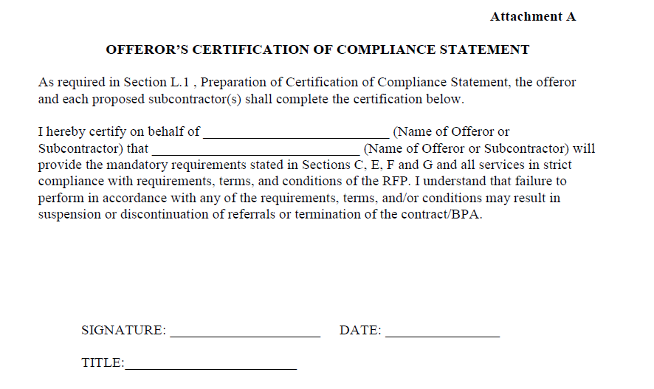
Attachment A

Slide 8
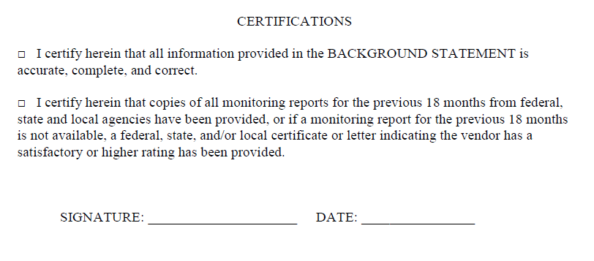
Attachment B
Provide a background statement, and be sure to sign:

Slide 9
Definitions of EMQs/Units
EMQ = estimated monthly quantity
Do not confuse the EMQ with the number of clients that are estimated to utilize the contract.
One Unit = 30 minutes (counseling); one day (residential treatment); or one UA test/sweat patch test

Slide 10
Definition of EMQs, cont’d
i.e. Two units of 2010 per week = One hour of counseling
31 units per month = 31 days of residential tx
Three units of 1010 per month = 3 UA tests per mo.
One unit of 5012 per plan = 1 sex offender evaluation and report
EMQs are our best guesstimate and not a guarantee.
If we are selecting more than one vendor, you should divide the EMQs by the number of vendors being selected.

Slide 11
Catchment areas
Some defined by county
Some more narrowly defined (specific cities within a county)

Slide 12
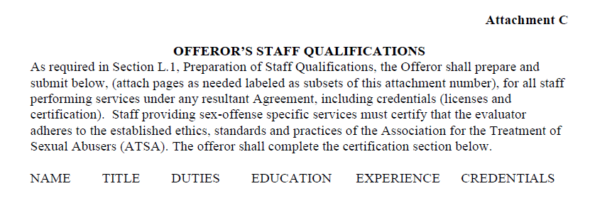
Attachment C
Under duties, please add which project codes the staff person will perform (2010, 2020, 6010, etc.)

Slide 13
Attachment C (Cont’d)
Please either provide staff members’ license numbers (if applicable), OR a copy of the actual license
Sign staff qualification statements that no staff members providing services to federal clients are under investigation for or charged with a criminal offense and/or on probation/parole, etc. AND have not been convicted of any sexual offense or are required to register

Slide 14
Attachment D
Provide three references

Slide 15
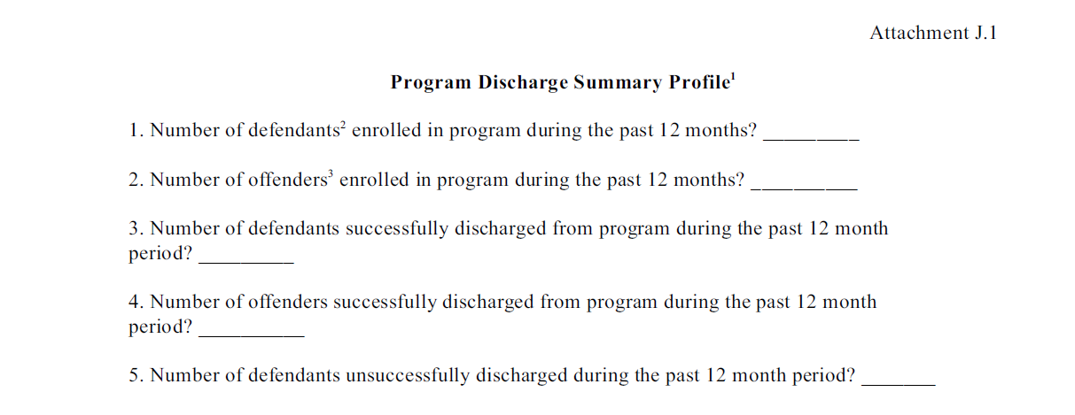
Attachment J.1
You must fill in your statistical data on this form

Slide 16
Project Codes 2000/6000
Attend reentry program proceedings as requested
Provide verbal and written reports on the defendants’/offenders’ progress as required by the Court.

Slide 17
Residential Tx – 2001/2002
The vendor shall provide:
(1) A minimum of 6 hours of structured programmatic activities per weekday (e.g., life skills training, GED, employment readiness, etc.), 3 hours of which shall be clinical group counseling.
(2) A minimum of 1 hour of individual clinical counseling per week.

Slide 18
Dual Diagnosis 6001/6002
The vendor shall provide:
(1) A minimum of 6 hours of structured programmatic activities per weekday (e.g., life skills training, GED, employment readiness, etc.), 3 hours of which shall be clinical group counseling.
(2) A minimum of 1 hour of individual clinical counseling per week;
AND …

Slide 19
Dual Diagnosis 6001/6002
(1) An initial mental health intake assessment and report and/or a psychiatric examination and report, and/or a psychological evaluation and report;
(2) Urine specimen collection and reporting results;
(3) Psychotropic medication;
(4) Administration of psychotropic medication;
(5) Medication monitoring;
(6) Clinical consultation with USPO/USPSO;
(7) Individual/group/family counseling.

Slide 20
*Project Code 1001*
How differentiated from 2001/2002 ?
Provides for a re-entry phase to facilitate the individual’s separation from the Therapeutic Community and successful integration to society.
No minimum # of hours of treatment per day
Client might be job searching/working during the day and receiving some programming at night?
May be less expensive, since receiving less counseling?

Slide 21
Sex Offender Tx
Clinicians shall adhere to the Code of Ethics and Practice Standards and Guidelines published by the Association for the Treatment of Sexual Abusers (ATSA) and polygraphers by American Polygraph Association (APA)
New APA standard – no more than 5 polygraphs in one day (3 sexual history polygraph tests in one day)
Every polygraph session has to be at least 90 minutes long

Slide 22
Price Evaluation
Life of the agreement totals (EMQs x price x all three years)

Slide 23
Example
 | Year One | Year Two | Year Three
1010 (EMQ 10) | 20.00 (x 12) | 25.00 (x 12) | 30.00 (x12)
2010 (EMQ 5) | 70.00 (x12) | 80.00 (x12) | 90.00 (x12)
5012 (EMQ 1) | 1500.00 (x12) | 1600.00 (x12) | 1700.00 (x12)
The LOA for Year One is $9,000.

Slide 24
“MUSTS”
All proposals must:
Include prices for all three years
Answer all questions and include all attachments
Be submitted by ___ 2021 at 4:30pm

Slide 25
Onsite evaluation
Provide physical facilities that preserve both the integrity of the confidential relationship and the personal dignity of the client.
Maintain a physical facility that meets all applicable federal, state and local regulations (e.g., building codes), including adequate access for defendants/offenders with physical disabilities)
Not endanger the health and safety of employees, clients and the community

Slide 26
Determination of responsibility
It is the policy of the Government that purchases shall be made from, and contracts awarded to, responsible prospective contractors only.
Check the list of Parties Excluded from Federal Procurement or Non-Procurement Programs
Check the References provided with the proposal

Slide 27
Helpful…
It would be helpful if you could place tabs on your proposal identifying all required documents
-Statement(s) certifying you will provide all mandatory requirements (including compliance statements for each subcontractor)

Slide 28
Helpful (Cont’d)
-ALL monitoring reports (for previous 18 months)
(January 1, 2020 through June 30, 2021)
-Applicable business/operating licenses
*if not required, indicate why
-Local fire, safety and health codes
*if not required, indicate why

Slide 29
Help with RFP
Questions can be submitted in writing to
RFP_Requests@canp.uscourts.gov
Will update with written answers on the website daily, if possible.

Slide 30
Website
www.canp.uscourts.gov
Under subheading “Vendors”

Slide 31
Questions?

