Slide 1
Urine Collection and Chain of Custody Procedures
District of New Mexico
U. S. Probation & Pretrial Office

Slide 2
Importance of Observed Collection
Never underestimate what an addict will do to conceal drug use or try to “beat” the drug test.
Although the Statement of Work establishes guidelines for unobserved urine collections, this method is highly discouraged.
Collector must receive approval from the supervising officer before an unobserved collection takes place.
Temperature strips must be available for unobserved urine collections.
For safety reasons, do not observe a collection from someone you know unless it has been disclosed to your supervisor.

Slide 3
Collector Certification
All personnel who perform urine collections must be trained by a U. S. Probation/Pretrial Officer or Lab staff. The on-site laboratory will maintain a file on each collector which will include documentation of proficiency and a signed acknowledgment-of-training form.

Slide 4
Urine Collection- Step 1
The defendant/offender should be escorted from the waiting area to the collection area by the collector.
Be cognizant of body language and potential efforts to conceal a “cheating” device.
The collector and the client are the only people present in the collection area at this time. Multiple collections should not occur at the same time.

Slide 5
Urine Collection – Step 2
The collector shall obtain supplies from a secured area in view of the defendant/offender.
Chain of Custody (COC) form
Specimen ID labels
Tamper-evident seals
Specimen bottles
Wide-mouthed cups
Tamper-evident bag

Slide 6
Urine Collection – Step 3
The collector fills out the top portion of the COC form (Client’s legal court name, DOB, PACTS number, supervising officer, collection date/time, and medications).
Client information will be provided on Prob45 or other forms provided to the vendor
Have client initial next to medications and admitted drug use section

Slide 7
Urine Collection – Step 4
Before urine is collected
The client signs a specimen ID label.
The client affixes the signed specimen ID label to the bottle and affixes the matching specimen ID label to the COC form.
Affix label to bottle BEFORE going into the bathroom to ensure bottle mix-up does not occur

Slide 8
Urine Collection- Step 5
The collector maintains control of all supplies and escorts the defendant into the restroom.

Slide 9
Urine Collection- Step 6
Ask the Client to remove any bulky (concealing) clothing, and to roll up sleeves so that wrists/forearms are in clear view.
It may be necessary to have client adjust clothing in order to adequately determine that a device is not being concealed on his/her body.
Do not allow clients to carry in any items such as purses and phones

Slide 10
Urine Collection- Step 7
The client will rinse hands with cold water (no soap) and dry them thoroughly.
Make sure Offender/defendant rinses under fingernails
Purpose of rinse is to eliminate any possible agents on client’s hands

Slide 11
Urine Collection- Step 8
Hand bottle to client
Collector positions themselves to directly observe client voiding urine into collection container
Ask defendant to fill bottle to the top.
Client must provide a minimum of 15mL for testing

Slide 12
Urine Collection- Female
A clean, wide-mouthed disposable cup is used to catch urine. The urine is then transferred to the specimen bottle by the defendant/offender.

Slide 13
Urine Collection- Female
Because it may be impossible to see urine leave the female body and enter the disposable cup, request a mid-stream collection.
Ask the female client to begin the flow of urine into the toilet, stop the flow, then resume the flow into the collection cup.
Client’s other hand should be in clear view, away from the collection cup.
Ensure client does not dip cup into toilet bowl to collect water
Client will pour the urine from the collection cup into the specimen bottle.

Slide 14
Urine Collection- Step 8
Observe for any instances of adulteration
In any instances of suspected falsifications, Probation Office must be notified immediately after the collection

Slide 15
Urine Collection- Step 9
After urine is collected, the defendant places the cap tightly on the bottle to prevent leakage.
The COLLECTOR will NEVER handle the filled specimen bottle.

Slide 16
Urine Collection- Step 10
At the collection area, the CLIENT places the tamper-evident seal over the top of the bottle with both sides of the seal securing the bottle top and adhering to the sides of the bottle. At least one end of the seal must be placed over the specimen ID label.

Slide 17
Urine Collection – Step 10 (Continued)
The client will write his/her initials on the tamper evident seal AFTER it is affixed to the bottle. Sharpie/permanent markers are recommended

Slide 18
Urine Collection – Step 10 (Continued)
The offender/defendant places the UA specimen into the tamper evident bag, along with an absorbent sheet.

Slide 19
After urine has been collected
The client shall read, sign, and date the COC form under offender/defendant certification.
The collector shall complete the notes section of COC form, REVIEW the form for completeness, and then read, sign and date under collector certification.

Slide 20
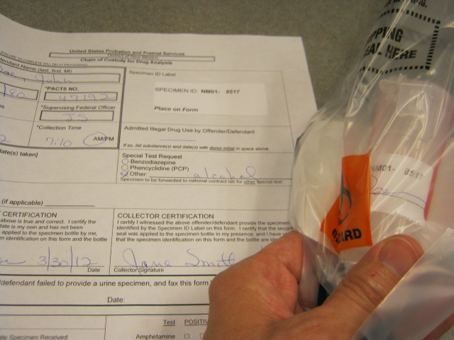
Urine Collection – Step 13
Before placing the COC form into the specimen bag, the collector has the opportunity to do a final review and verify that –
1) specimen ID numbers on the COC form and specimen bottle match.

Slide 21
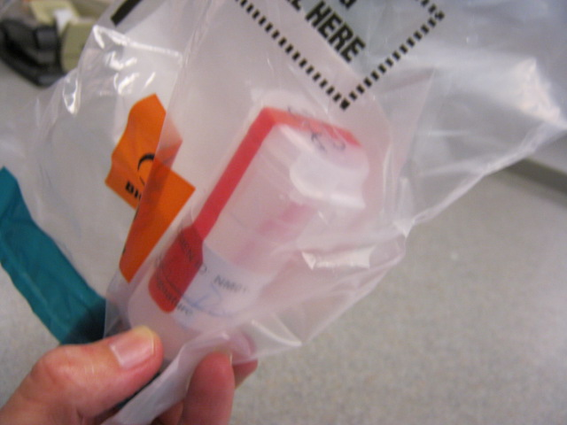
Urine Collection – Step 13 (Continued)
2) specimen bottle is TIGHTLY sealed.
3) specimen bottle is affixed with
A) defendant-signed specimen ID label.
B) defendant-initialed tamper-evident seal that is placed OVER the specimen ID label.
C) security seal is intact and adhering to both sides of the bottle.

Slide 22
Urine Collection-Step 14
The collector folds the form and places it into the document pocket of the tamper-evident bag.
The collector, in the presence of the defendant, removes the adhesive strip and folds the top of the bag over the front pocket guidelines.

Slide 23
DILUTE URINE
Dilute urine can be an indication that a defendant is attempting to “flush” his/her system with excess fluid to avoid drug detection.
Products sold to “beat drug tests” commonly use flushing as the method to avoid detection.
It is important to note on the COC form if urine appears dilute.
If a pattern of providing dilute urines is noticed, the collector should communicate this with the Probation Officer.

Slide 24
storage and delivery
Postal Delivery – bagged specimen with COC form shall be placed in a mailer box provided by USPO. Verify mailer boxes address below:
US PROBATION
P.O. Box 777
Albuquerque, NM, 87103-9861
Staff Courier – bagged specimen with enclosed COC form will be delivered to
500 Gold Avenue SW, Suite #10226
Albuquerque, NM 87102

Slide 25
Storage and delivery
The collector will store the UA specimens in a secured and locked refrigerator for no more than 3 days for postal delivery, or no more than 4 days for staff courier.
Specimens being tested for alcohol should be mailed off on the same day of collection, or no later than the next day.
As a general rule specimens should be delivered to the testing laboratory as soon as possible.

Slide 26
Stalling & Subsequent Attempts
If the defendant is unable to provide an immediate sample, the collector may allow the defendant to drink not more than 8 ounces of liquid within a 30-minute time period.
If the defendant is still unable to provide a specimen within two hours, the collector will complete the appropriate section of the COC form noting the stall and fax it to the supervising officer.
The unused bottle and any other supplies used should be destroyed.
Save COC for documentation

Slide 27
Failure to Provide
If the client does not appear for random drug testing, or if the client does not provide sufficient volume, the vendor must notify the Probation Office within 24 hours.

Slide 28
Supplies
All supplies are provided by USPO
Use only supplies provided by USPO and do not use USPO supplies for other collections
Submit a Supply Request Form via e-mail to nmppdb_druglab@nmp.uscourts.gov or fax 505-348-2716 when more supplies are needed. Please allow 7-10 days for shipping

Slide 29
Common “no tests” or rejected samples
TAMPER SEALS
1) broken
2) no initials
SIGNATURES
1) defendant and/or collector missing on COC form
2) defendant missing on specimen ID label on bottle

Slide 30
No Tests
SPECIMEN ID LABELS
1) none on bottle and/or not signed
2) none on COC form
3) numbers on bottle and COC do not match
URINE VOLUME
1) insufficient
2) complete leakage

Slide 31
SPECIMEN AND COC FORM –
1) No COC received
2) No specimen received
NO MATCH –
1) specimen ID numbers on COC form/bottle
2) defendant initials on tamper seal do not match defendant name(do not allow nick names, or aliases)
3) name/Pacts # on COC form does not match defendant signature on COC form
4) name/Pacts # on COC form does not match defendant signature on bottle

Slide 32
Correctable errors (detected in presence of defendant)
Broken tamper seals – ok to place a second seal over the first – be sure top seal is initialed
Specimen ID labels – ok to place a second label over the first, on the bottle and/or COC form – be sure top label on bottle is signed. Specimen ID numbers on bottle and COC must match.

Slide 33
POP QUIZ
True or False?
The specimen ID number on the bottle must match the specimen ID number on the COC form.
True or False?
After placing the tamper-evident seal over the top of the bottle, the defendant writes his/her initials on it.

Slide 34
POP QUIZ
When does the defendant sign the specimen ID label and affix it to the bottle, before or after urine is collected?
When does the defendant sign the COC form, before or after the urine is collected?

Slide 35
Contact information
Questions may be directed to:
Drug Analysis Technicians
Janean Perea
Stephanie Dameron
Rose Rivera
Marissa Castillo
Drug Lab Supervisor
Patricia Rodriguez
505-348-2734
Email: nmppdb_Druglab@nmp.uscourts.gov
Physical Address: 500 Gold Ave. SW, Suite 10226, Alb, NM 87109

